Slide 1
LockIN
LockIN
CS 147 Week 4 Concept Video: Team 3

Slide 2

Our Team
Erika V.
John S.
Marie M.
Jessica Cao
2026
Ethan Chang
2026
Julia Luyten
2025
Ingrid Nordberg
2025

Slide 3
Roadmap
Intro & Recap
Problem & solution
Market research
Design values
Tasks
Storyboards
Concept Videos

Slide 4
Recap
01
Previously - Screen Time Strava: inspired by Strava – an interactive social app that lets you make bets with friends to “stake” money for screen-time habits and manage screen time
Main insights from Connor: Struggled with digital distractions while working on his startup (12+ hours a day), Elias also found himself trying to exercise more to reduce screen habits
Insights from Participants: We saw over 70% reduction when they staked – with main feedback being they “felt social pressure” and the “monetary incentives” work well, but they wouldn’t voluntarily participate since it only had downside.
Combining insights + doing more prototyping & feedback testing, we understood that a combo of social pressure & monetary incentives allow for strong habits change. Now introducing: LockIN!

Slide 5
Problem & Solution
Problem:
How might we create a more mindful relationship with technology for those who are deeply immersed in it?
It’s hard for people to avoid digital distractions and balance their work, and these screen-time obsessions lead to stress and burnout.
Solution:
A social incentive app that rewards users monetarily to limit screen time from distractions by competing with friends (the social pressure) in a “Weakest link” format.

Slide 6
Name, One Liner, and Value Proposition
We chose LockIN since its catchy and relatable. The name also is important to what our app tries to solve – having people lock-in and avoid digital distractions, to focus better. We think the catchy LinkedIN like ring will help capture user engagement for our audience – young individuals, GenZ, and millennials.
Our one-liner captures our entire app concept concisely, we combine social pressure with monetary incentives to create external factors to improve user habits.
LockIN users engage in a unique experience that 1) helps them mitigate digital distractions but 2) rewards them for better performance and lets them compete with friends for a cool social, gamified aspect!
LockIN
the social incentives app for screen time management
Value proposition:

Slide 7
Market Research

Slide 8
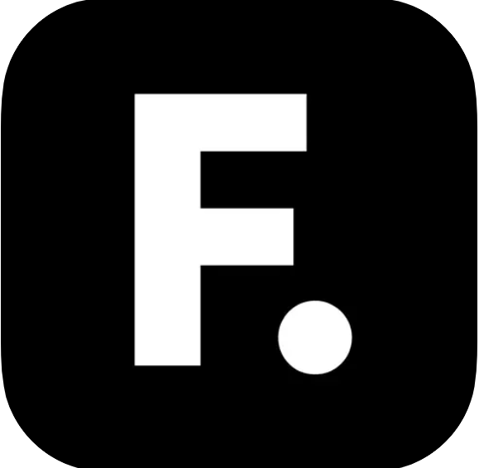
Forfeit
How it works: You say what you're going to do, when you're going to do it, and how much money you'll forfeit if you don't do it. If you don’t, the app takes your money.
Why it's bad: It doesn’t work since people don’t like staking money (no upside, don’t want to lose money) and is mainly used for physical exercise accountability. There also isn’t a social aspect which we found in our insights as valuable for screen time reduction.
LockIn is unique because beyond staking, it creates an upside opportunity combined with a social aspect to form healthy behaviours and avoid digital distractions.
Implication: Market needs a more gamified, social version of staking money for habit formation.

Slide 9
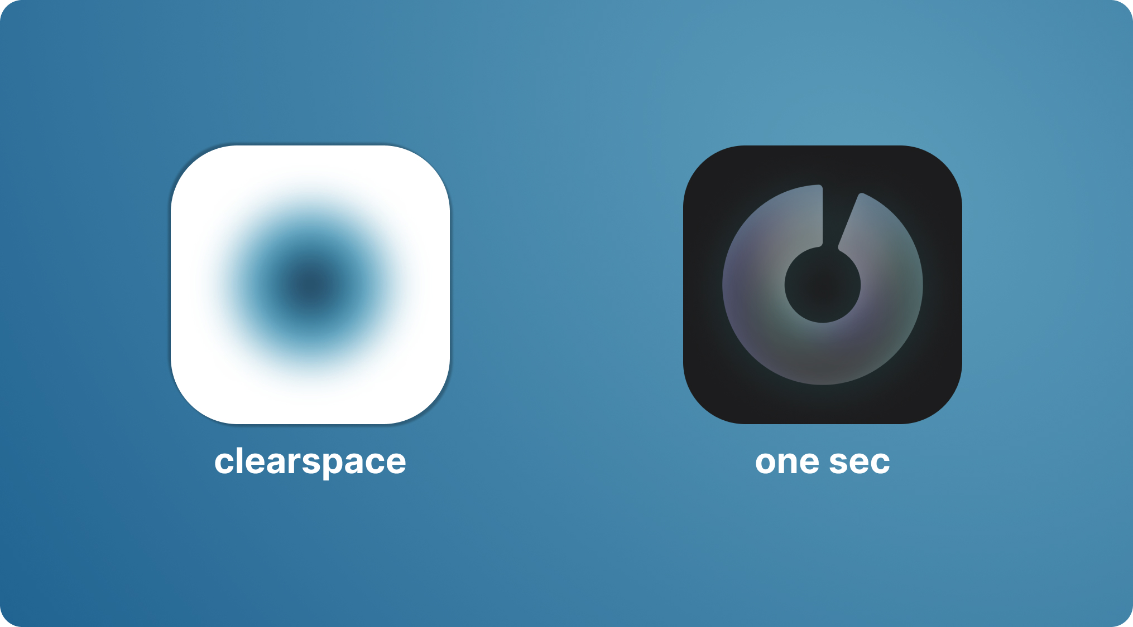
Clearspace
How it works: It encourages you to complete a centering exercise before entering an app. It allows you to set limits at which point the app interrupts your use. It also allows you to track data overtime about your usage.
Why it's bad: Clearspace doesn’t utilize any social pressure or monetary pressure, meaning users still have to ultimately rely on their own willpower to not override nudges by Clearspace.
LockedIn is focused on creating social pressure as the main focus to help users reduce screen time.
Implication: The market needs social or monetary pressure surrounding screen time to keep users motivated.

Slide 10

Jomo
How it works: Jomo allows users to set up catered screen time rules, including app limits, scheduled sessions, focus timer, and strict mode. It allows users to journal about their screen time habits. It also allows users to unlock screen time through physical activity.
Why it: Jomo’s focus is on individual limits but lacks social pressure. While users can view other statistics, the pressure of competing directly, especially with financial stakes added, is uniquely effective.
LockedIn is unique because its focus is around a social peer-to-peer aspect that discourages users to spend time on digital devices, beyond individual limits.
Implication: Individual limit screen apps fail to recognize that behavior change often lies in external factors like incentives and pressures.

Slide 11

Opal
How it works: Opal is a screen time management app that helps you focus via app blocking, mindfulness, gamified individual milestones. Users can also “focus with friends.”
Why it's bad: While Opal does have some gamification and “focus buddies” it struggles with keeping users hooked with the incentive to continuously use the platform,
Implication: Users have strong appeal to gamified features but need stronger external incentives and motivations to continuously use & improve their habits.
LockedIn is unique because it extends the social gamification to monetary incentives, “Weakest-link” style where users are discouraged to engage with digital devices.

Slide 12
Comparisons
 | Forfeit | Clearspace | Jomo | Opal | LockIN
Staking | Y | x | x | x | Y
Monetary Upside | x | x | x | x | Y
Social pressure | x | x | x | x | Y
Competitions | - | x | x | Y | Y
Time limits | x | Y | Y | Y | Y
Track friends | x | Y | x | Y | Y

Slide 13
Value Considerations
Direct Stakeholders: Users, peers/friends of users, health and wellness advocates, ad-based revenue
Indirect Stakeholders: Family members of users, employers of users, mental health professionals
Our app promotes personal wellness and positive social accountability. It encourages users to engage in competitions with friends to reduce screen time. We want to help build a healthier relationship with technology by helping people set boundaries, focus on the present, and build stronger habits.
Based on our research and user feedback, we recognize that while the competitive aspect of the app can motivate users, it’s important to be mindful of potential negative behaviors such as feelings of guilt, shame, or even over-attachment to the “staking” aspect of the competition. We aim to prioritize responsible use, ensuring that any staking features are balanced with an emphasis on healthy, supportive competition. We’re actively considering ways to avoid fostering unhealthy habits by promoting mindfulness, encouraging limits, and offering positive reinforcement, while maintaining transparency around the goals of the app.

Slide 14
Two Tarot Cards of Tech
The Infinite Scroll:
Ethical Implication: The app’s competitive, staking nature might inadvertently cause users to focus too much on winning or accumulating points, which could lead to an unhealthy obsession with minimizing screen time. This reflects an underlying value tension between promoting healthy habits and creating an alternate obsession with reducing screen time.
Addressing the Implication: We can introduce mindfulness reminders and focus on incremental improvements rather than binary wins/losses, ensuring that users are focused on long-term wellness rather than just minimizing screen time.
The Stacks:
Ethical Implication: The staking (financial) component could blur the lines between motivation and gambling. We must prevent users and their friends from treating the app as a betting platform, which could lead to over-attachment to monetary incentives, overshadowing the primary wellness goal.
Addressing the Implication: To fix this, we can cap the stakes or introduce non-monetary rewards, like achievements or wellness badges, to reduce the focus on the financial aspect and re-emphasize personal improvement.

Slide 15
Tasks
Simple
Join a pre-set competition
To use the app, all users join a preset competition
Time in video: 0.28
Moderate
Post your daily stats to the competition feed, analyze the stats, and compare with friends
Most users will check, analyze, and compare stats, but also adds a layer of sophistication
Time in video: 0.56
Complex
Set up your own custom competition, setting goals, stakes and curating list of members
Custom competitions will be made only by power & top users
Time in video: 1.14

Slide 16
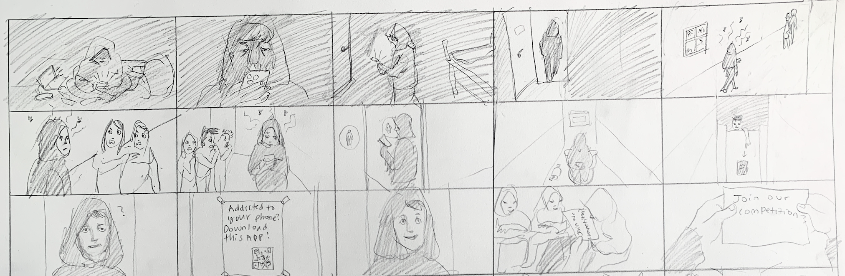
Storyboard
MC is addicted to screens
Scrolling continuously & content
Scrolls while walking
Crashes into the door
Enter scene: cruising into hallway
People despise him and look down
Talking behind his back
Enters bathroom: new scene
Bathroom part 2
Is alerted by a mysterious man
Confused and scene cuts to the promotion
LockIN introduction
MC develops some interest
User is prompted
Task 1: the user joins with randoms / friends

Slide 17
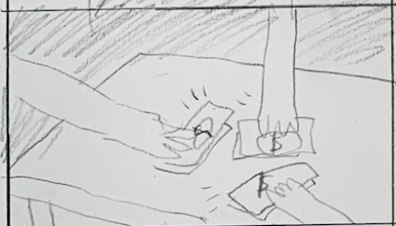
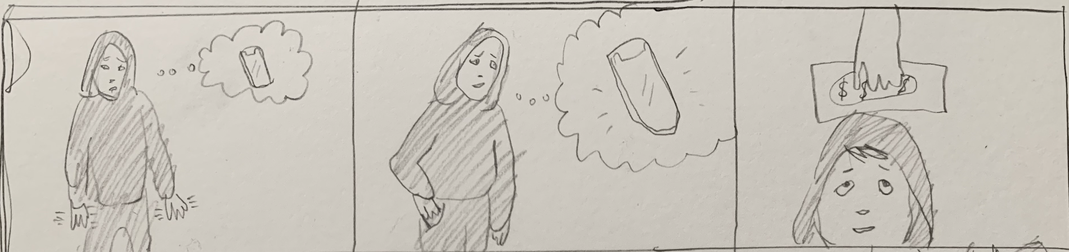
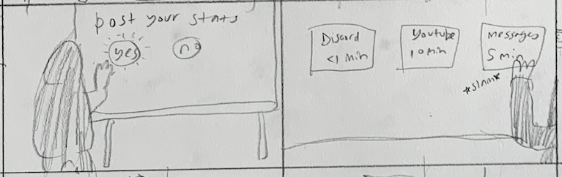
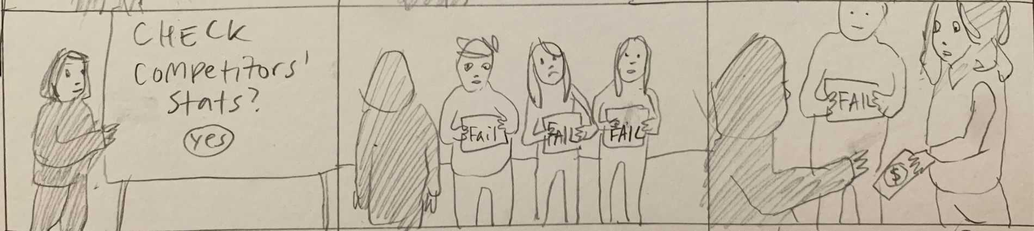
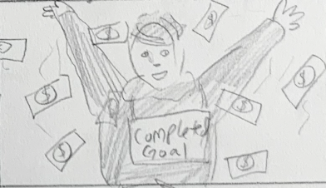
Storyboard
User stakes money into the pot
Scene 1: withdrawals
Desperate need & longing for digital device use
Reminded of monetary benefits
Stats competition and comparisons
Posting individual stats
Continuation
Checks on competition: everyone fails
Last user succumbs to loss! And receives the payout.
Winner! Last one standing!

Slide 18
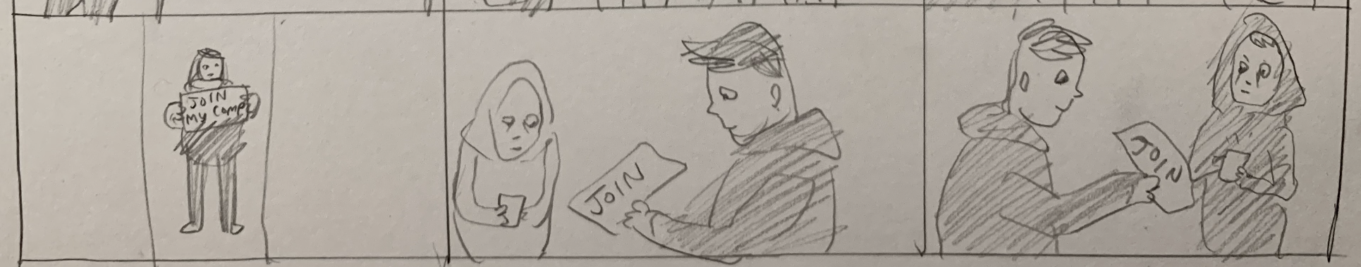
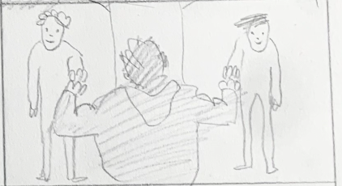
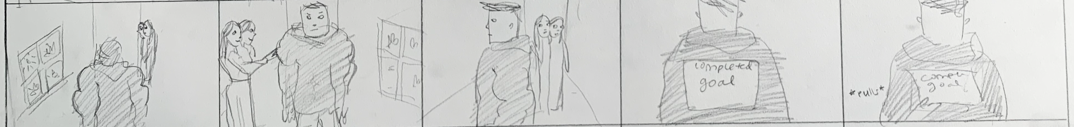
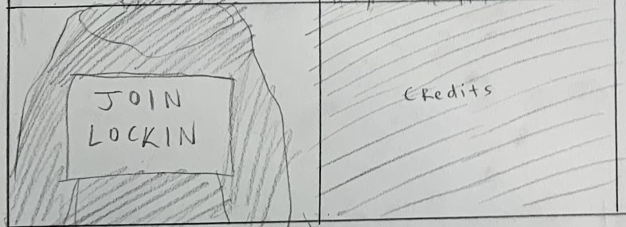
Storyboard
Cut scene: user now is a power user
Creates a competition for users to compete in
Finds like-minded individuals to join
People treat the MC differently after improved habits
Roll final scene – intro Lockin ad

Slide 19
Video
Youtube Video Link

